Slide 1

CSE101-Lec#20
Strings

Slide 2
Outline
Introduction to string
Declaration
Initialization
Reading and writing strings
functions of the standard input/output library (stdio.h)
Processing of strings.
String Manipulation Functions from the String Handling Library
Comparing strings
Determining the length of string

Slide 3

Introduction
Use of C standard library functions for strings and characters:
Easy string and character processing
Programs can process characters, strings, lines of text, and blocks of memory
These techniques are used to make
Word processors
Page layout software
Typesetting programs
Quick yak:
Discussion for string usage can be exemplified mentioning
Google Translator!!!

Slide 4
Fundamentals of characters
Characters
Building blocks of programs
Every program is a sequence of meaningfully grouped characters
Character constant
An int value represented as a character in single quotes
'z' represents the integer value of z (122 ASCII value).

Slide 5
Fundamentals of strings
Strings
Array of characters treated as a single unit called string:
Can include letters, digits and special characters (*, /, $)
String literal (string constant) - written in double quotes
“Lovely Professional University."

Slide 6
Fundamentals of strings
Strings are arrays of characters
String is a pointer to first character (like array)
Value of string is the address of first character
Each element of the string is stored in a contiguous memory locations.
Terminated by a null character(‘\0’) which is automatically inserted by the compiler to indicate the end of string.

Slide 7
String Definition
They are defined as
char array_name[size];
e.g. char carname[30];
or char *carname;
It defines an array name and reserves 30 bytes for storing characters and single character consumes 1 bytes each.
Since the last byte is used for storing null character so total number of character specified by the user cannot exceed 29.

Slide 8
String Initialization
String Initialization
Two ways:
Define as a character array or a variable of type char *
char color[] = "blue"; //char array
Or char color[] = { 'b', 'l', 'u', 'e', '\0' };
char *colorPtr = "blue"; //pointer variable
Remember that strings represented as character arrays end with '\0'
color has 5 elements
b | l | u | e | \0
b | l | u | e | \0
color
Temporary
*colorPtr

Slide 9
char *colorPtr = "blue"; //pointer variable
Printf(“%s”, colorPtr);
Is correct way to use pointer to char. But:
char *colorPtr; //pointer variable
scanf(“%s”, &colorPtr);
printf(“%s”, colorPtr); /* invalid statement %s don’t work with pointer to char */

Slide 10
String Input/Output
Inputting strings
Use scanf.
scanf("%s", word);
Copies input into word[]
Do not need & (because a string is a pointer)
Remember to leave last place in the array for '\0‘.
Because array knows no bounds the string written beyond char array size will overwrite the data in memory.
Displaying strings
Use printf.
printf("%s", word);

Slide 11
#include <stdio.h>
void main()
{
char carname[20]; //string char array
printf(“Enter the name of your car: ");
scanf("%s", carname);
// to display the input
printf(“\nName of car is %s", carname);
} //end main
Program to read and display string
Enter the name of your car: XUV500
Name of car is XUV500
Output

Slide 12
How?
The last program will print only a single word not the sentences with white spaces?
That is if input is
Lovely Professional University
Output will be:
Lovely
So how to print:
Lovely Professional University
use gets and puts

Slide 13
#include <stdio.h>
void main()
{
char name[100]; //string char array
puts(“\nEnter a string: ”);
gets(name); //to input string with space
printf(“\nString is: ”)
puts(name); //to output const string
}//end main
Program to print strings with white spaces using library functions
Enter a string:
Lovely Professional University
String is:
Lovely Professional University
Output

Slide 14
#include <stdio.h>
void main()
{
char name[]={“Lovely Professional University"}; //string char array
int i=0;
while(name[i]!='\0') //untill null character
{
printf("%c", name[i]);
i++;
}//end while
}//end main
Program to print strings character by character using loop.
Lovely Professional University
Output

Slide 15
String Handling Library
Functions defined in #include<string.h>
String handling library provides many useful functions:
Manipulate string data(copy and concatenate)
Comparing strings
Determine string length
Search strings

Slide 16
String Manipulation Functions
List of string manipulation functions
Function prototype | Function description
char *strcpy( char *s1, const char *s2 ) | Copies string s2 into array s1. The value of s1 is returned.
char *strncpy( char *s1, const char *s2, int n ) | Copies at most n characters of string s2 into array s1. The value of s1 is returned.
char *strcat( char *s1, const char *s2 ) | Appends string s2 to array s1. The first character of s2 overwrites the terminating null character of s1. The value of s1 is returned.
char *strncat( char *s1, const char *s2, int n ) | Appends at most n characters of string s2 to array s1. The first character of s2 overwrites the terminating null character of s1. The value of s1 is returned.

Slide 17
strcpy() and strncpy()
strcpy() copies the entire second argument string into first argument.
strcpy( s1, s2);
strncpy() copies the first n characters of second string argument into first string argument.
strncpy( s1, s2, 4);
A null character ('\0') is appended explicitly to first argument, because the call to strncpy in the program does not write a terminating null character.
The third argument is less than the string length of the second argument.

Slide 18
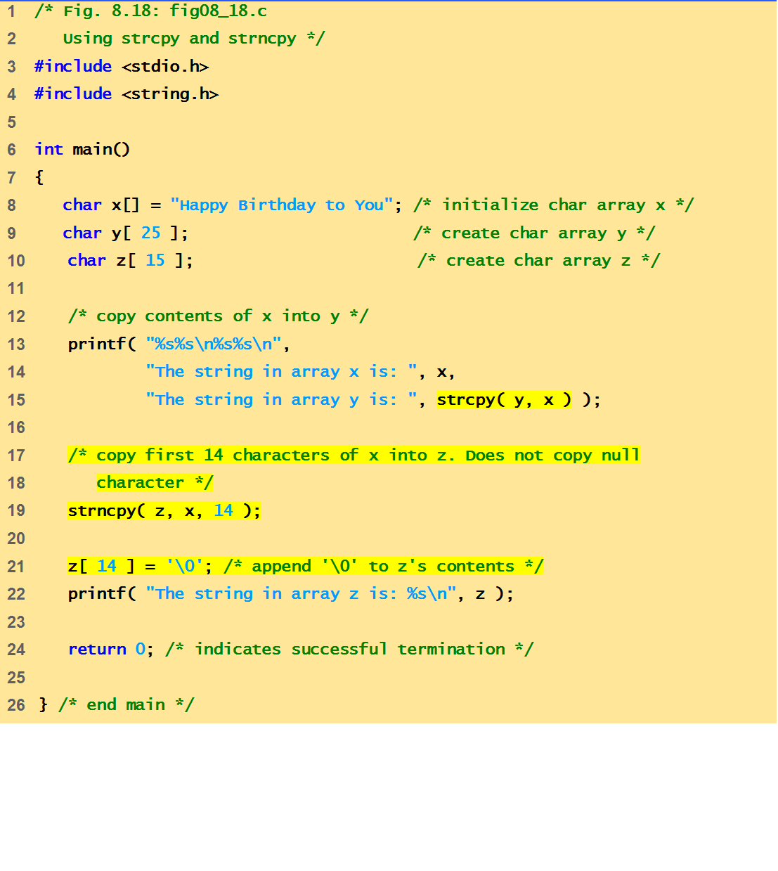
Example Code
This program demonstrates string manipulation/ processing functions: strcpy() and strncpy()

Slide 19
Output
The string in array x is: Happy Birthday to You
The string in array y is: Happy Birthday to You
The string in array z is: Happy Birthday

Slide 20
strcat()
Function strcat appends its second argument string to its first argument string.
strcat( s1, s2);
The array used to store the first string should be large enough to store
the first string
the second string and
the terminating null character copied from the second string.

Slide 21
strncat()
Function strncat appends a specified number of characters from the second string to the first string.
strncat( s1, s2, 6)
A terminating null character is automatically appended to the result.

Slide 22
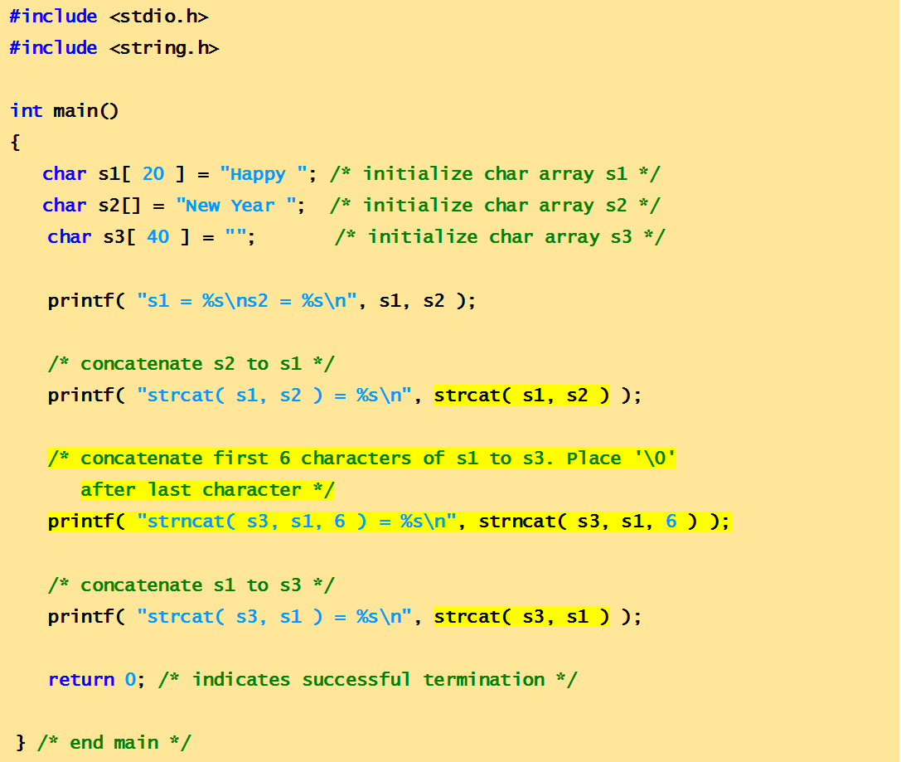
Example Code
This program demonstrates string manipulation/ processing functions: strcat() and strncat()

Slide 23
output
s1 = Happy
s2 = New Year
strcat( s1, s2 ) = Happy New Year
strncat( s3, s1, 6 ) = Happy
strcat( s3, s1 ) = Happy Happy New Year
Quick yak:
Ask students to print their names as:
Ankur Sharma
Sharma Ankur
Ankur S.
A. Sharma

Slide 24
Comparison Functions of the String Handling Library
Comparing strings
Computer compares numeric ASCII codes of characters in string
strcmp() Compares its first string argument with its second string argument, character by character.
Function strncmp() does not compare characters following a null character in a string.

Slide 25
strcmp()
int strcmp( const char *s1, const char *s2 );
Compares string s1 to s2
Returns
a negative number if s1 < s2,
zero if s1 == s2
a positive number if s1 > s2

Slide 26
strncmp()
int strncmp( const char *s1, const char *s2, int n);
Compares up to n characters of string s1 to s2
a negative number if s1 < s2,
zero if s1 == s2
a positive number if s1 > s2

Slide 27
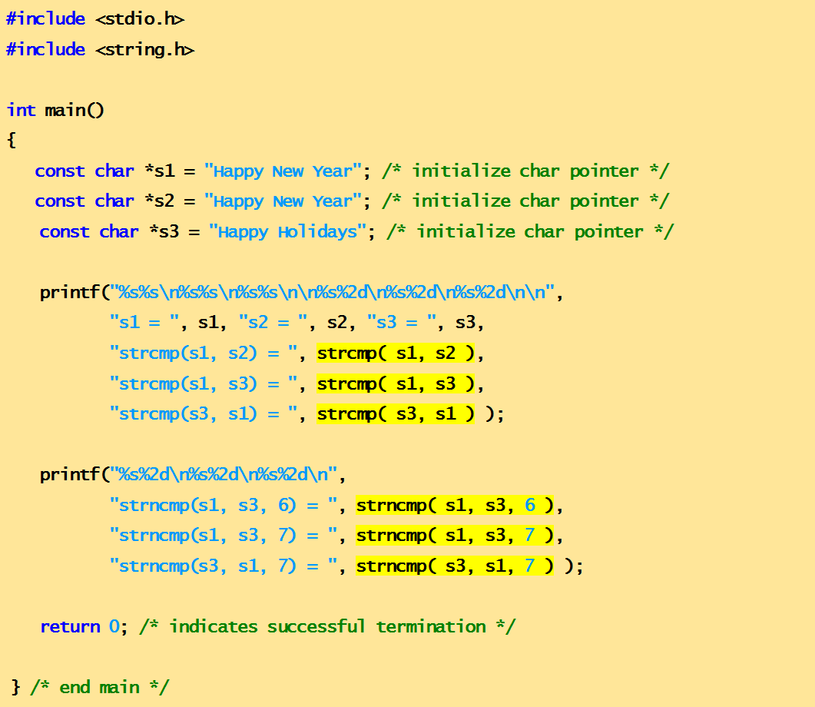
Example Code
This program demonstrates string comparison functions: strcmp() and strncmp()

Slide 28
Output
s1 = Happy New Year
s2 = Happy New Year
s3 = Happy Holidays
strcmp(s1, s2) = 0
strcmp(s1, s3) = 1
strcmp(s3, s1) = -1
strncmp(s1, s3, 6) = 0
strncmp(s1, s3, 7) = 1
strncmp(s3, s1, 7) = -1
Quick yak:
Students to create a friendship game:
Based on the score out of -1,0,1 of first names of two people….

Slide 29
Determining the length of string
strlen()
Function strlen in #include<string.h>
Function strlen() takes a string as an argument and returns the number of characters in the string
the terminating null character is not included in the length

Slide 30
#include <stdio.h>
#include <string.h>
void main()
{
/* initialize 3 char pointers */
const char *string1 = "abcdefghijklmnopqrstuvwxyz";
const char *string2 = "four";
const char *string3 = "Boston";
printf("%s\"%s\"%s%d\n%s\"%s\"%s%d\n%s\"%s\"%s%d\n",
"The length of “,string1,"is", strlen(string1),
"The length of “,string2,”is“, strlen(string2),
"The length of “,string3,”is“, strlen(string3));
} /* end main */
Program demonstrates string length function strlen()

Slide 31
The length of "abcdefghijklmnopqrstuvwxyz" is 26
The length of "four" is 4
The length of "Boston" is 6

Slide 32
Next Lecture
Mining different types of data from string …??
String conversion functions

